Slide 1
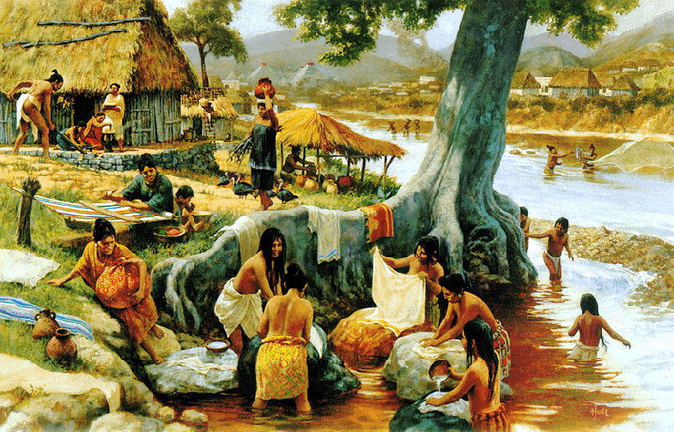
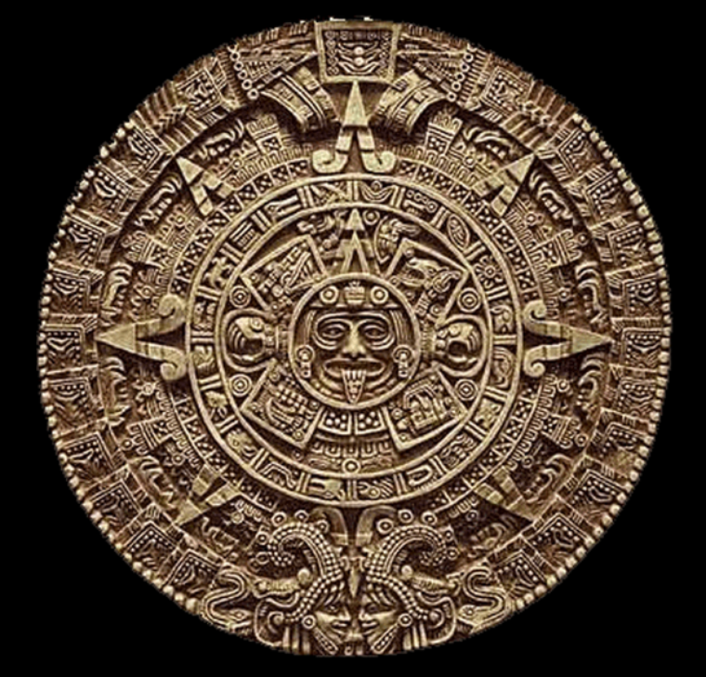
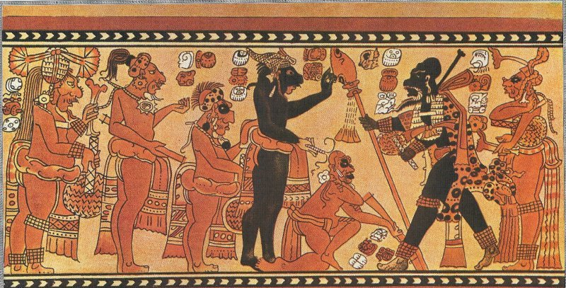
Mayans

Slide 2
Directions
You have been split up into groups. Your task is to learn about your specific Meso-American civilization. To help you, guiding questions and links have been provided. Once complete, you will be in charge of teaching your classmates the information you have learned.
Steps:
Read information on slides and guiding questions.
Discuss readings and questions with group.
On chart paper, you and your group will take notes on major ideas from your readings and your questions in your own words to help teach class

Slide 3
Geography
1.When did the Mayans live?
2. Explain where the Mayans lived if you were using a map.
3. Describe the climate and geography of where the Mayans lived. Do you think the climate was beneficial or detrimental to the Mayans?
http://www.webpages.uidaho.edu/arch499/nonwest/mayan/geography.htm
http://mayancountdown.net/mayan_maps.html

Slide 4
Technology
Briefly describe the 3 methods of farming used by the Mayans in your own words. Which method do you think is most effective?
Explain two significant innovations made by the Mayans.
What were the purposes and importance of the calendars used by the Mayans?
http://mayas.mrdonn.org/agriculture.html
http://www.theoldexplorer.com/index.php/maya-technology
http://www.history.com/topics/mayan-scientific-achievements

Slide 5
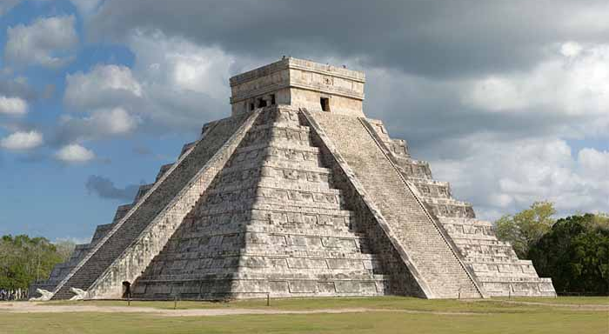
Culture
Describe the image below.
Where else have you seen something like this before? Predict what this was used for.
What does this image tell you about Mayan society?
How did social class impact education of the Mayans? Use the link below!
http://www.incamayanaztec.com/ancient-mayan-education.html

Slide 6
Collapse
Briefly summarize the reasons as to why the Mayans disappeared.
How do the disappearance theories of the Mayans compare to the collapses of other major civilizations? Are any similar?
http://latinamericanhistory.about.com/od/Maya/p/What-Happened-To-The-Ancient-Maya.htm

